Slide 1








2018
2017
The Power of the Dark Side:
Offensive PowerShell Workshop
Build an immutable application infrastructure with Nano Server, PowerShell DSC, and the
release pipeline
Ravikanth Chaganti
Will Schroeder and Jared Atkinson

Slide 2
about_Authors
@harmj0y and @jaredcatkinson on Twitter
Red Team and Hunt at @SpecterOps
Microsoft PowerShell/CDM MVPs
will [at] harmj0y.net | jared [at] invoke-ir.com

Slide 3
Agenda
Introduction/setup
Token Manipulation
Get-System to Get-AccessToken
Mimikatz
Passwords, tickets, and detection
PowerShell without powershell.exe
UnmanagedPowerShell/PSInject, attacks and detection
(If time) Alternate PowerShell Hosts
Searching for and abusing alternate hosts
(If time) Subversive PowerShell Profiles

Slide 4
Workshop Goals
Hacking is fun! We want you give you hands on with the tools we’re familiar with :)
Plus you can’t defend against what you don’t know!
Expose you to specific security-related PowerShell subject areas that you may not be familiar with
Give you practical defensive advice and let you play with hands on detection of some of these techniques

Slide 5
DISCLAIMER
We hope you trust us :)
We will be running malicious code!
You have been warned…

Slide 6
Labs
Download the lab material from the ./workshops/Offensive PowerShell Workshop/ folder from https://github.com/HarmJ0y/2018
Will be updated on https://github.com/psconfeu/2018
Download the materials to an exclusion folder for your antivirus :)
We recommend temporarily disabling Defender:
From an elevated prompt:
PS\> Set-MpPreference -DisableRealtimeMonitoring $True

Slide 7
Why We Chose PowerShell (offense)
Allows us to automate previously time-consuming/expensive tradecraft
Provides:
Full .NET access
Execution through a trusted Microsoft binary
Direct access to the Win32 API
Ability to assemble malicious binaries in memory
Default installation on Win7+

Slide 8
Why We’re Diversifying Our Offense
The PowerShell security team is awesome!
PowerShell == the most secure scripting language, ever
Version 5 is phenomenal from a security perspective:
Deep script block logging
Script block auto logging
Enforcement of security protections for ALL PowerShell hosts
AMSI hooks for AV
Constrained language mode
Just-enough-administration (JEA)

Slide 9
Why We Chose PowerShell (defense)
Fits in with our point-in-time sweep approach methodology
Provides:
Full .NET access
Execution through a trusted Microsoft binary
Direct access to the Win32 API
Default installation on Win7+
Robust remoting functionality
No additional configuration changes necessary!

Slide 10


Slide 11


Slide 12
Notes:
Obligatory #sadjoey

Slide 13
2018
2017
Build an immutable application infrastructure with Nano Server, PowerShell DSC, and the
release pipeline
Token Manipulation
From Get-System to Get-AccessToken
Ravikanth Chaganti

Slide 14
Windows Authentication Overview
Windows creates a logon session upon successful authentication
User credentials (if any) are stored in lsass.exe
Credentials may be used later for Single Sign On
Access tokens define the security context of a process/thread
When a process/thread wants to act in a user context it uses a token
Tokens are tied to logon sessions and determine how the cred is used
Credential → Logon Session → Access Token→ Thread/Process
Notes:
Typical credentials: NTLM hash, Kerberos tickets, plaintext passwords

Slide 15
Token Types & Impersonation Levels
1) Primary - a process token
OS uses token’s credentials to authenticate remotely.
2) Impersonation - a thread token
Threads use impersonation tokens to impersonate other security contexts
OS might use token’s credentials to authenticate remotely
Impersonation tokens have impersonations levels, but we won’t worry about that here
Impersonation tokens can be “stolen” (cloned) from other processes!

Slide 16
Windows Authentication Overview
Logon Session
LogonId: 3142081
LogonType: 2
Auth: NTLM
Credentials: hunter2
Process
ProcessId: 8028
LogonId: 3142081
ProcessName: cmd.exe
Thread
ThreadId: 6245
LogonId: 3142081
Logon Session
LogonId: 501918
LogonType: 9
Auth: Kerberos
Credentials: nojumpininthesewer!
Thread
ThreadId: 1257
LogonId: 501918
Thread
ThreadId: 3201
LogonId: 3142081

Slide 17
Get-System
One common attacker technique: elevate to a SYSTEM context for specific post-ex actions
Method 1:
Enable SeDebugPrivilege, open a handle to a SYSTEM process with OpenProcessToken(), duplication the token with DuplicateToken(), and set the token to your process with SetThreadToken()
Method 2:
Create a named pipe, create a service that uses cmd.exe to echo text to the named pipe, use ImpersonateNamedPipeClient() to impersonate SYSTEM

Slide 18
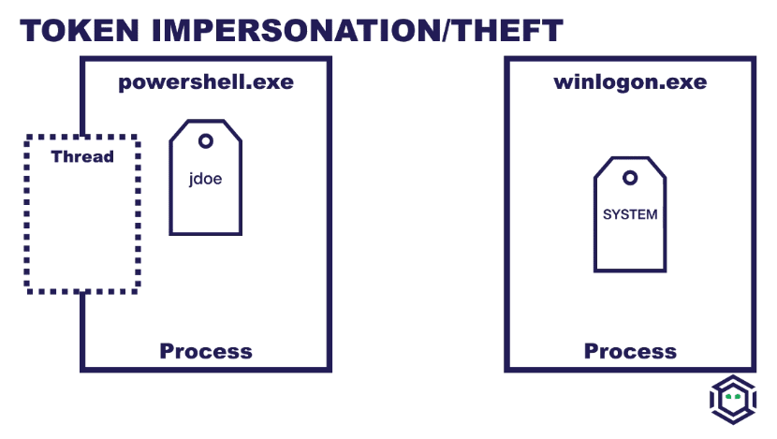

Slide 19
Demo
Get-System under the hood

Slide 20
Detecting Token Impersonation
Some attack tools do not clean up duplicate/created tokens!
Token impersonation applies to a specific thread, so we can compare process token to thread tokens
Looking for weird “anomalies”
We built a tool (Get-AccessToken) that will enumerate current access tokens at a very granular level

Slide 21
Get-AccessToken
Enumerate processes/threads (Get-Process)
OpenProcess* - Returns a handle to a process object
OpenProcessToken* - Opens an access token associated with a process
OpenThread* - Returns a handle to a thread object
OpenThreadToken* - Opens an access token associated with a thread
GetTokenInformation* - Retrieves a specified type of information about an access token
* uses PSReflect for Win32 API access!
Notes:
There’s nothing you can’t do in PowerShell!

Slide 22
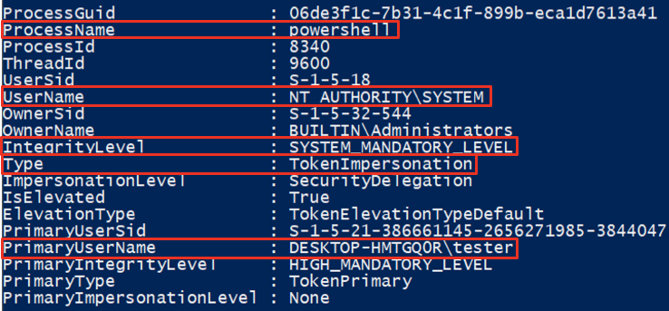
Get-AccessToken vs Get-System

Slide 23
Demo
Detection of token impersonation with Get-AccessToken

Slide 24

2018
2017
Mimikatz
Build an immutable application infrastructure with Nano Server, PowerShell DSC, and the
release pipeline
Ravikanth Chaganti
Defensive Enemy #1 :)

Slide 25
Mimikatz Background
The current de facto blackhat/whitehat hacking tool
Written by Benjamin Delpy (@gentilkiwi)
Best known for extracting passwords from memory though various credential packages, but WAY more than just that!
The current best overall command breakdown is Sean Metcalf’s “Unofficial Guide to Mimikatz & Command Reference” (https://adsecurity.org/?page_id=1821)
Weaponized independently (mimikatz.exe), integrated into most open-source remote access tools, and packaged into Invoke-Mimikatz !

Slide 26
Common Mimikatz Modules (part 1)
lsadump - interact w/ local security authority (LSA)
::lsa - extracts AD passwords (on a DC)
::sam - extracts passwords stored in SAM
::secrets - extracts LSA secrets
sekurlsa - interacts w/ LSASS
::wdigest - plaintext in-memory creds, fixed as of KB2871997
::tspkg - terminal services credentials
::logonpasswords - pull creds from all available providers
...lots more!
Notes:
Not a complete listing

Slide 27
Common Mimikatz Modules (part 2)
token - interact with user tokens
::list - list all available tokens
::elevate - impersonate specific tokens
kerberos - interface with the Kerberos API
::list - list currently registered tickets
::golden - ticket forgery
privilege - enable various user rights
::debug - most common, needed for more “interesting” options

Slide 28
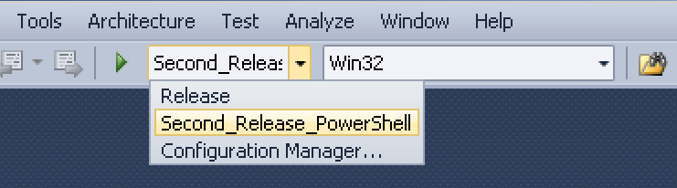
Invoke-Mimikatz
Written by Joe Bialek while on the Microsoft Office 365 red team
Can load Mimikatz completely in memory through a customized PE loader
The Mimikatz Visual Studio project has an Invoke-Mimikatz build target:
Notes:
Base64 encode the DLL, replace in Invoke-Mimikatz
PowerShell build vs. standard -> returns a pointer to string instead of stdout
so you can get a System.String instance

Slide 29
Kerberos: In English (hopefully…)
A client proves who they are to a domain controller using their password/hash and receives a ticket-granting-ticket (TGT) in return
This TGT has signed info that proves the user’s identity
To access a given service in a domain the client requests a service ticket (TGS) from the DC by presenting the TGT
The ending TGS is presented to the target service (which proves that the DC authenticated the client) and the service decides whether to grant or deny access
Notes:
e.g. MsSQLSvc/SQL.domain.com

Slide 30
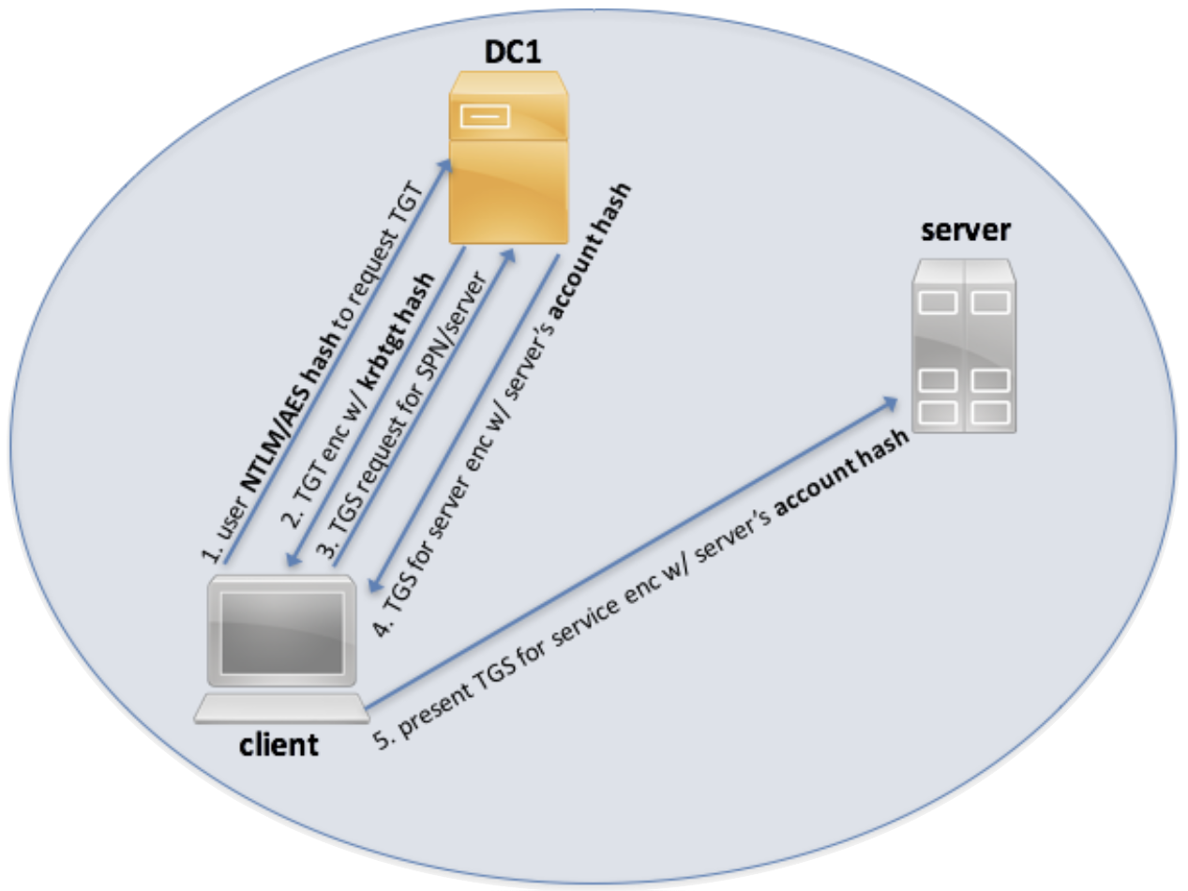
Kerberos 101

Slide 31

Forged Kerberos Tickets
Ticket granting tickets (TGT) are ultimately protected by the hash of the krbtgt account
If we can compromise this hash, we can forge our own Kerberos ticket granting tickets!
These are Mimikatz “golden tickets”

Slide 32
Demo
Invoke-Mimikatz functionality
Extracting passwords, ticket forgery

Slide 33
PowerShell Scriptblock Autologging
Introduced in PSv5, scriptblock autologging automatically logs any scriptblock execution that contains a predetermined “dirty word” deemed suspicious
Dirty words can be dumped with the following command:
[ScriptBlock].GetField('signatures', 'NonPublic, Static').GetValue($null)

Slide 34
PowerShell Scriptblock Autologging
Logged to the Microsoft-Windows-PowerShell/Operational log under event ID 4104 with the “Warning” error level.
Get-WinEvent -LogName Microsoft-Windows-PowerShell/Operational -FilterXPath '*[System[EventID=4104 and Level=3]]'
Notes:
Level 3 -> “warning”
Auto-logging -> warning level
GPO enabled script-block logging is “Verbose” level

Slide 35
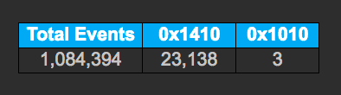
Detecting Credential Dumping
@Cyb3rWard0g has an excellent blog post* where he analyzes calls to OpenProcess against lsass
Configure Sysmon to monitor Process Access Events (Event ID 10) for lsass.exe
Look for the “GrantedAccess” field of 0x1410, 0x143A, or 0x1010
*https://cyberwardog.blogspot.com/2017/03/chronicles-of-threat-hunter-hunting-for_22.html

Slide 36
Detecting Ticket Forgery
We needed a tool that enumerates Kerberos ticket information at a granular level, so we built one!
Get-KerberosTicketGrantingTicket.ps1
Stock Mimikatz forged tickets have a few anomalies:
10 year lifetime, RC4/NTLM encryption, others
But these can be modified!
Our “general” heuristic:
Check if the session username matches the clientname pulled from the ticket-granting-ticket

Slide 37
Get-KerberosTicketGrantingTicket
Enumerate LSA Logon Sessions
LsaEnumerateLogonSessions - Returns a handle to an array of session data structures.
LsaGetLogonSessionData - Queries each session handle for its associated information (logon type, user, etc.).
Request each Logon Session’s Ticket Granting Ticket
LsaRegisterLogonProcess - Establishes a connection to the Local Security Authority Server.
LsaCallAuthenticationPackage - Calls a specified function implemented by an authentication package (Kerberos).
LsaDeregisterLogonProcess - Closes the connection to the Local Security Authority Server.

Slide 38
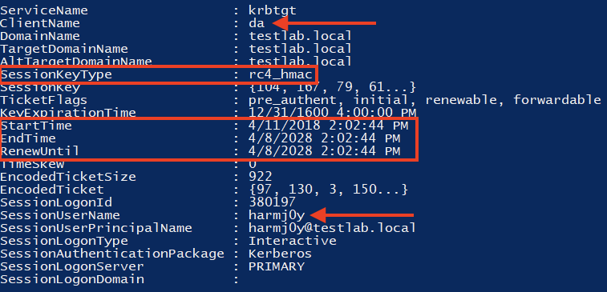
Forged TGT

Slide 39
Demo
Detecting forged Kerberos Tickets

Slide 40

2018
2017
PowerShell Without powershell.exe
Build an immutable application infrastructure with Nano Server, PowerShell DSC, and the
release pipeline
Ravikanth Chaganti

Slide 41
PowerShell != powershell.exe !
PowerShell == System.Management.Automation.(ni.)dll
C# can easily be used to build a PowerShell pipeline runner in a dozen lines of code
There are a number of offensive-oriented projects that implement this approach:
SharpPick
@jaredhaight’s PSAttack project
@Cneelis‘s p0wnedShell
@ben0xa’s NPS project

Slide 42
Demo
Building a simple C# PowerShell Runner

Slide 43
UnmanagedPowerShell
@tifkin_’s response to the “can PowerShell run without powershell.exe” problem
UnmanagedPowerShell provides the ability to run PowerShell code in an unmanaged (C/C++/non-.NET) process
Loads up the .NET Common Language Runtime (CLR) in the current process (needs code injection for a foreign process)
Grabs a pointer to the CLR AppDomain
Loads a custom C# assembly that runs PowerShell

Slide 44
Invoke-PSInject.ps1
Invoke-PSInject.ps1:
takes a PowerShell script block (base64-encoded)
patches the decoded logic into the architecture appropriate ReflectivePick.dll
injects the result into a specified ProcessID
Lets you super-easily run PowerShell code in any process you want!
This is what Empire’s process injection capability is built on!
Notes:
“Why do this/chicken and the egg” -> Empire process injection!

Slide 45
Demo
Injecting PowerShell

Slide 46
Detecting PSInject: WMI load events
WMI event subscription query:
SELECT FileName, ProcessID FROM Win32_ModuleLoadTrace WHERE FileName LIKE "%System.Management.Automation%.dll"
Possible actions:
LogFileEventConsumer with a customized event log
ActiveScriptEventConsumer to trigger custom .VBS handling code
CommandLineEventConsumer to do something like auto-dumping the target process’ memory

Slide 47
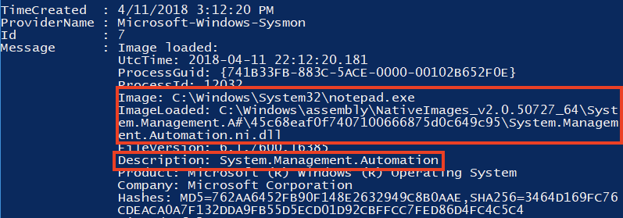
Detecting PSInject: Sysmon
If you start Sysmon with the -l argument, it will log module loads (Sysmon event ID 7)
Does this look suspicious?
Notes:
ni == native image

Slide 48
Detecting Generic Injection
Our detection relies on certain assumptions:
To execute, code must have an associated thread
Code executed by a thread should live on disk somewhere
Get-InjectedThread’s detection process:
Iterate through threads
Identify each thread’s base memory address
Query the memory page that the base address belongs to
Ensure that the memory page is currently committed (MEM_COMMIT)
Flag, if memory page contents are not from disk (!MEM_IMAGE)

Slide 49
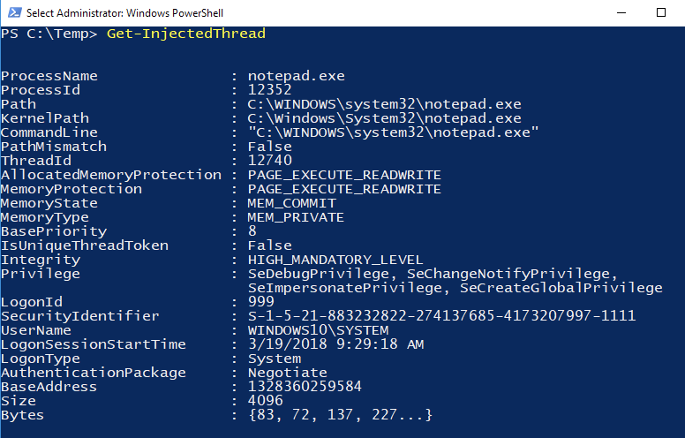
PSInject vs. Get-InjectedThread

Slide 50
Demo
Hunting for Injection

Slide 51
2018
2017
Alternate PowerShell Hosts
Build an immutable application infrastructure with Nano Server, PowerShell DSC, and the
release pipeline
Ravikanth Chaganti

Slide 52
“Official” Alternate PowerShell Hosts
There are a number of signed/”official” Microsoft binaries that host System.Management.Automation
Abuse of any of these binaries can grant you:
Avoiding lockdown of powershell.exe
Bypass of application whitelisting policies that allow anything signed by Microsoft (most of them)
Might be a constrained language mode bypass
Avoiding of command line logging and some Sysmon logging

Slide 53
Searching for “Official” hosts
So how can you go about finding these hosts?
Characteristic 1:
These binaries are almost always C#/.NET .exes/.dlls
Characteristic 2:
These binaries have System.Management.Automation.dll as a referenced assembly
Characteristic 3:
These may not always be “built in” binaries
Notes:
We’re OK dropping signed Microsoft binaries in ops!
Identify runscripthelper w/ a script
Open in DNSpy, looking in main, processcheck script -> PS related?
see PowerShell, PS code added, Invoke() is called
Can we influence the PS code that’s executed?
Yes - click on param (scriptPath, shows references)
What calls ProcessSurfaceScript -> right click/analyze, trace params up -> from arg[1]
Defenses -> not a proper PowerShell host so no eventID 400, but
still subject to scriptblock auto-logging and standard scriptblock logging, and AMSI
Event ID 400 (“Engine state is changed from None to Available”), upon the start of any local or remote PowerShell activity.

Slide 54
Demo
Searching for and Abusing
Alternate PowerShell Hosts

Slide 55
2018
2017
Bonus: Subversive Profiles
Build an immutable application infrastructure with Nano Server, PowerShell DSC, and the
release pipeline
Ravikanth Chaganti

Slide 56
PowerShell Profiles
Scripts that run every time an “official” PowerShell host (meaning powershell.exe/powershell_ise.exe) starts
Meant for shell customization, not loaded with remoting!
Profiles can be subverted with malicious proxy functionality!
More information:
http://www.exploit-monday.com/2015/11/investigating-subversive-powershell.html

Slide 57
PowerShell Profile Locations

Slide 58
Lab: Subversive Profiles
Build a subversive profile that hides any powershell.exe instances from Get-Process
Check out the “call operator”!
(Bonus) food for thought:
How would you write a malicious Get-Credential proxy?
How would you use a subversive profile for lateral movement?

Slide 59
Summary
There’s lots of offensive PowerShell out there!
There are ways to detect or mitigate the vast majority of the public offensive toolsets!
You can’t detect what you’re not aware of
Play with these tools hands on in your environment and work out detections that work for you!

Slide 60
Questions?

